Slide 1
HOTEL RESERVATION ANALYSIS
MADE BY ZOA AHMED

Slide 2
SQL PROJECT
01

Slide 3

INTRODUCTION
The hospitality industry is marked by its complexity, with hotels navigating a myriad of factors such as seasonal fluctuations, evolving consumer preferences, and competitive landscapes. In this dynamic environment, data analysis emerges as a crucial tool for hotels to gain a competitive edge. By harnessing the power of data, hotels can uncover hidden trends, identify untapped opportunities, and tailor offerings to meet the diverse needs of their guests. Through this project, we aim to showcase how SQL can serve as a robust framework for extracting actionable insights from hotel reservation data, empowering hotels to make informed decisions that drive both guest satisfaction and business success.

Slide 4

DATASET OVERVIEW
The dataset provided encompasses various attributes crucial for understanding hotel reservations, including booking ID, guest demographics (number of adults and children), duration of stay (weekend and week nights), meal plans, room types, lead time, arrival dates, market segments, average room prices, and booking statuses. These attributes collectively form a rich source of information for exploring guest preferences, booking trends, and the effectiveness of marketing strategies employed by the hotel. By delving into the dataset, we aim to uncover actionable insights that can inform strategic decision-making and enhance the overall guest experience.

Slide 5
ANALYSIS
01
02
03
PROBLEM STATEMENT
SOLUTIONS
RECOMMENDATIONS

Slide 6
PROBLEM STATEMENT
In today's competitive hospitality landscape, hotels face the challenge of optimizing resource utilization, maximizing revenue, and delivering personalized experiences to guests. To address these challenges effectively, it's imperative to understand the dynamics of hotel reservations, including factors influencing booking decisions, trends in guest preferences, and the efficacy of different marketing approaches. By leveraging SQL to analyze the dataset, our objective is to extract meaningful insights that can inform strategies for pricing, marketing, and resource allocation, ultimately driving improved business performance and guest satisfaction. Through this project, we aim to demonstrate the value of data-driven decision-making in the hotel industry and showcase the power of SQL in extracting actionable intelligence from large datasets.

Slide 7
OUR SOLUTIONS
INSIGHTS GENERATED
From the dataset analysis, it's evident that the majority of reservations (700 in total) were made, with Meal Plan 1 being the most popular choice among guests, constituting 527 reservations. Further exploration reveals that reservations typically include either one or two children, with the average price per room for these bookings being $127 for reservations with one child and $167 for those with two children. These insights underscore the significance of meal plan offerings in attracting guests and shed light on pricing dynamics influenced by the presence of children in reservations.
1.What is the total number of reservations in the dataset?
2. Which meal plan is the most popular among guests?
3. What is the average price per room for reservations involving children?

Slide 8
OUR SOLUTIONS
INSIGHTS GENERATED
4. How many reservations were made for the year 2017?
5. How many reservations were made for the month of july in 2018?
6. How many reservations fall on a weekend (no_of_weekend_nights > 0)?
7.What is the most commonly booked room type ?
In summary, the dataset comprises a total of 123 reservations made in the year 2017, with July 2018 witnessing 36 reservations. Among the room types, Room Type 1 stands out as the most popular choice, with 534 bookings. Furthermore, a notable portion of reservations, totaling 383, are scheduled to fall on weekends.

Slide 9
OUR SOLUTIONS
INSIGHTS GENERATED
Among the reservations, the highest lead time observed is 443 days, while the lowest lead time is 0 days, indicating a wide range in the duration between booking and arrival. The online market segment type emerges as the most common, with a total of 493 reservations categorized under the "Not_Canceled" booking status. Conversely, there are 207 reservations with a status of "Canceled." In terms of guest demographics, the dataset comprises a total of 1316 adults and 69 children across all reservations, highlighting the diverse composition of guests accommodated by the hotel.
8. What is the highest and lowest lead time for reservations?
9. What is the most common market segment type for reservations?
10. How many reservations have a booking status of "Confirmed“?
11. How many reservations have a booking status of "Canceled“?
12. What is the total number of adults and children across all reservations?

Slide 10
OUR SOLUTIONS
INSIGHTS GENERATED
13) What is the average number of weekend nights for reservations involving children?
14)How many reservations were made in each month of the year?
15) What is the average number of nights (both weekend and weekday) spent by guests for each room type?
16) For reservations involving children, what is the most common room type, and what is the average
--price for that room type?
17) Find the top 3 months with the highest number of reservations made in year 2017.
The dataset provides insights into the distribution of reservations across different months of the year, with varying levels of activity observed. Notably, October 2017 leads with the highest number of reservations at 40, followed closely by September and August 2017, with 35 and 14 reservations, respectively. Additionally, the average number of nights spent by guests for each room type reveals slight variations, ranging from 2.5 to 3.8 nights. Room_Type 1 emerges as the most common choice for reservations involving children, with an average room price of $121.5. These findings underscore the significance of understanding booking trends and guest preferences to optimize hotel operations and enhance guest satisfaction.

Slide 11
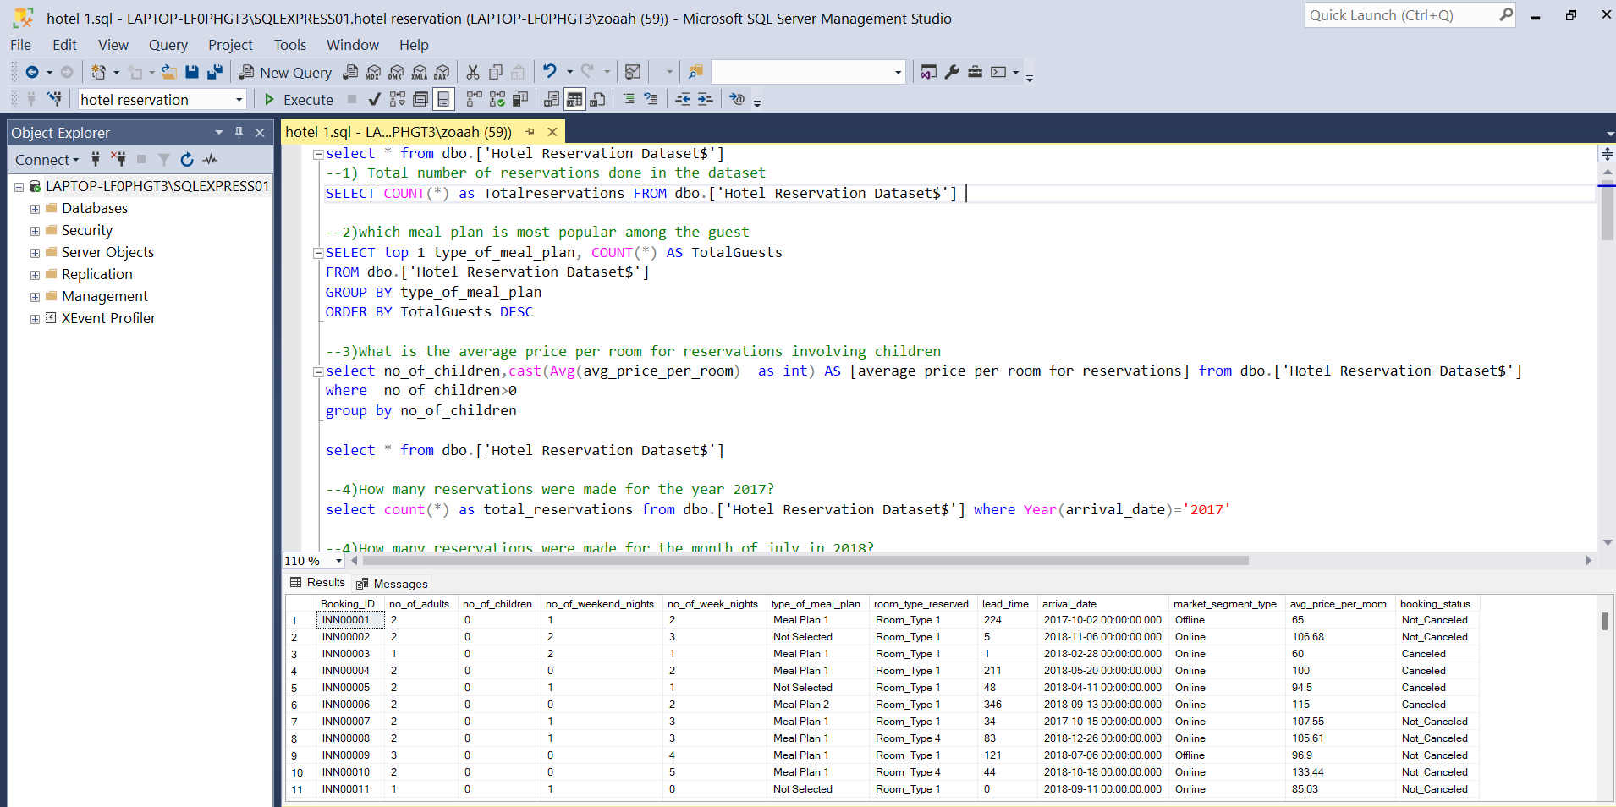
MS SQL SERVER Solved the business problems in MS SQL Server
NEPTUNE
MARS
VENUS
SATURN
It’s the farthest planet from the Sun
Despite being red, Mars is a cold place
Venus is the second planet from the Sun
It’s composed mostly of hydrogen and helium

Slide 12
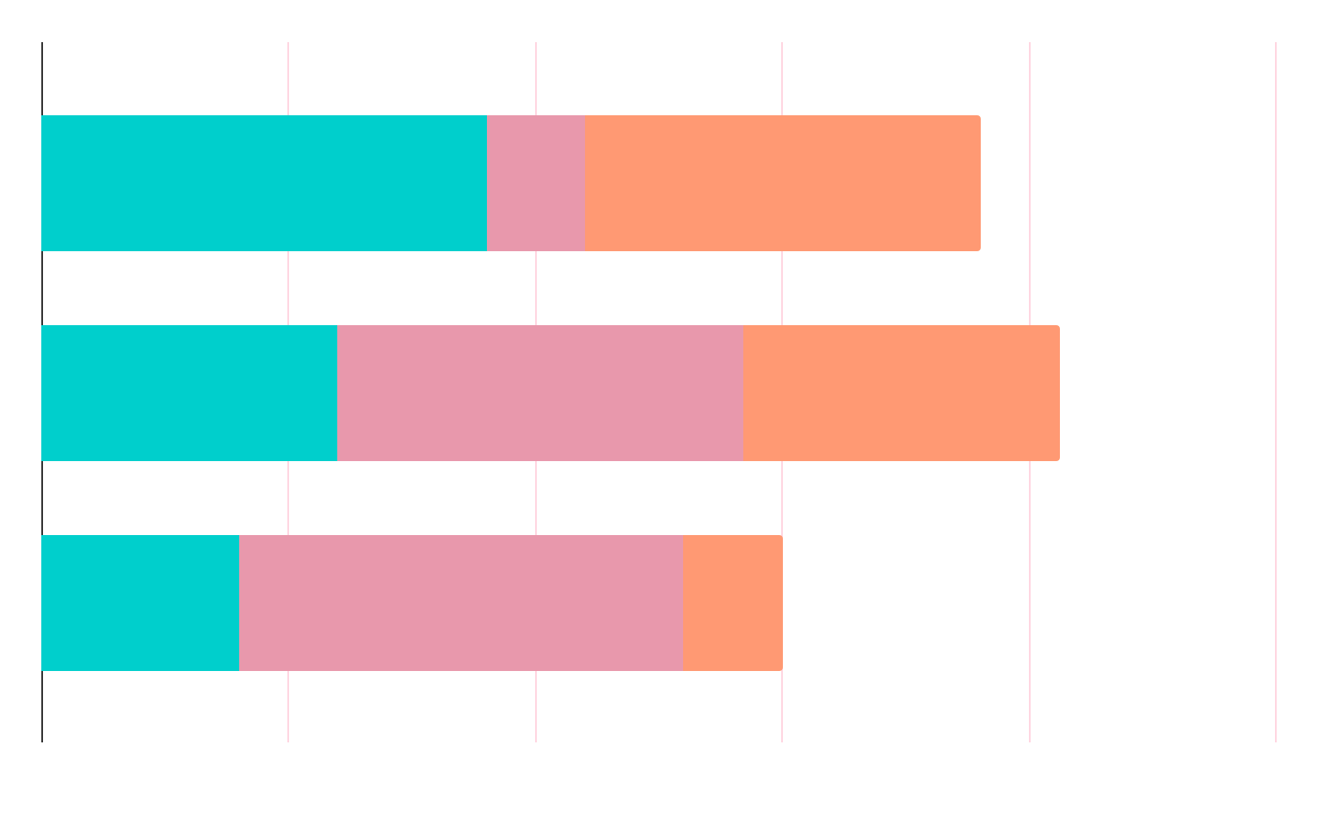
MARKET RESEARCH
1.
2.
3.
The most commonly booked room type is Room Type 1, with 534 bookings.
The most common market segment type for reservations is the online market segment, accounting for 581 reservations.
The online market segment emerges with the highest average price per room, reaching a peak of 258, showcasing its propensity for generating greater revenue per booking.

Slide 13
RECOMMENDATIONS
Based on the analysis of the hotel reservation dataset, several recommendations can be proposed to stakeholders to enhance operational efficiency and guest satisfaction. Firstly, optimizing pricing strategies based on insights into room type popularity, market segmentation, and lead time can maximize revenue generation while remaining competitive. Additionally, leveraging targeted marketing campaigns tailored to the most common market segments and peak reservation months can attract more guests and increase occupancy rates. Moreover, enhancing the booking experience by offering personalized meal plans and room packages aligned with guest preferences can foster loyalty and drive repeat bookings.
TOP RATED VALUES
30%
80%
50%
Saturn
Neptune
Venus

Slide 14

Furthermore, streamlining processes related to cancelled reservations and understanding factors contributing to cancellations can help mitigate revenue loss and improve resource allocation. Lastly, investing in data analytics tools and training for staff to continuously monitor booking trends and guest feedback will enable proactive decision-making and ensure the hotel remains responsive to evolving market dynamics and guest expectations.

Slide 15
THANK YOU

